Slide 1
Software Maintenance

Slide 2
Software Maintenance
What is Software Maintenance?
Software
Maintenance
is
a
of
very
broad
activity
that
includes
error
corrections, enhancements
capabilities,
deletion
of
obsolete
capabilities,
and
optimization.
2

Slide 3
Software Maintenance
Categories of Maintenance
•
Corrective maintenance
This refer to modifications initiated by
defects in the software.
•
Adaptive maintenance
It includes modifying the software to
environment.
match changes in the ever
changing
•
Perfective maintenance
It means improving processing efficiency or performance, or restructuring
the software to improve changeability. This may include enhancement of existing system functionality, improvement in computational efficiency etc.
3

Slide 4
Software Maintenance
•
Other types of maintenance
There are long term effects of corrective, adaptive and perfective changes.
This leads to increase in the complexity of the
deteriorating structure. The work is required to be
software, which reflect
done to
named
maintain it or to
reduce
it,
if
possible.
This
work
may
be
as
preventive
maintenance.
4

Slide 5
Software
Maintenance
Corrective (21
%)
Perfective
Adaptive
Preventive
Corrective
Preventive (4
%)
Perfective (50
%)
Adaptive (25
%)
Fig. 1: Distribution
of maintenance effort
5

Slide 6
Software Maintenance
Problems During Maintenance
)
Often the program is written by another person or group
of persons.
)
Often the program is changed by
clearly.
person
who
did
not
understand
it
)
Program listings are not structured.
)
High staff turnover.
)
Information gap.
)
Systems are not designed for change.
6

Slide 7
Software Maintenance
Maintenance is Manageable
A common misconception about
maintenance is that it is not manageable.
Report of survey
observations:
conducted
by
Lientz
&
Swanson
gives
some
interesting
1
Emergency debugging
12.4%
2
Routine debugging
9.3%
3
Data environment adaptation
17.3%
4
Changes in hardware and OS
6.2%
5
Enhancements for users
41.8%
6
Documentation Improvement
5.5%
7
Code efficiency improvement
4.0%
8
Others
3.5%
Table 1: Distribution of maintenance effort
7

Slide 8
Software
Maintenance
Kinds
of
maintenance
requests
1
New reports
40.8%
2
Add data in existing reports
27.1%
3
Reformed reports
10%
4
Condense reports
5.6%
5
Consolidate reports
6.4%
6
Others
10.1%
Table 2: Kinds of maintenance requests
8

Slide 9
Software Maintenance
Potential Solutions to Maintenance
Problems
)
Budget and effort reallocation
)
Complete replacement of the system
)
Maintenance of existing system
9

Slide 10
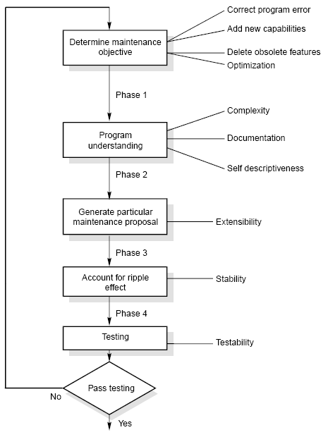
Software
Maintenance
The
Maintenance
Process
Fig. 2: The software
maintenance process
10

Slide 11
Software Maintenance
•
Program Understanding
The first phase consists of analyzing the program in order
to understand.
•
The
Generating Particular Maintenance Proposal
second
phase
consists
of
generating
a
particular
maintenance
proposal to accomplish the implementation of
the
maintenance objective.
•
Ripple Effect
The third phase consists of accounting for
consequence of program modifications.
all
of the ripple effect as a
11

Slide 12
Software Maintenance
•
Modified Program Testing
The fourth phase consists of testing the modified program to ensure that
the modified program has at least the same reliability level as before.
•
Maintainability
Each of these four phases and their associated software
quality
factors
attributes
are
critical
to
the
maintenance
process.
All
of
these
must
be
combined to form maintainability.
12

Slide 13
Software Maintenance
Maintenance Models
•
Quick-fix Model
This is basically an adhoc approach to maintaining software. It is a fire
fighting approach, waiting
for
the problem
to
occur
and
then
trying
to
fix
it
as
quickly
as
possible.
Problem
found
Fix it
Fig. 3: The quick-fix model
13

Slide 14
Software Maintenance
•
Iterative Enhancement Model
)
Analysis
)
Characterization of proposed modifications
)
Redesign and implementation
14

Slide 15
Software Maintenance
Analyze existing
system
Redesign current
version and implementation
Characterize
proposed modifications
Fig. 4: The three stage cycle of iterative enhancement
15

Slide 16
Software Maintenance
•
Reuse Oriented Model
The
reuse model has four main steps:
1.
Identification of the parts of the old system that are
reuse.
Understanding these system parts.
candidates for
2.
3.
Modification
of
the
old system
parts
appropriate
to
the
new
requirements.
Integration of the modified parts into the new system.
4.
16

Slide 17
Software
Maintenance
Old system
New system
Requirements
analysis
Requirements analysis
Components
library
Design
Design
Source code
Source code
Test data
Test data
Fig.
5: The reuse model
17

Slide 18
Software Maintenance
•
Boehm’s Model
Boehm proposed a model for the maintenance process
the economic models and principles.
based upon
Boehm
represent
the
maintenance
process
as
a
closed
loop
cycle.
18

Slide 19
Software
Maintenance
Management decisions
Proposed changes
Approved changes
Evaluation
Change implementation
Results
New version of
software
Fig. 6: Boehm’s model
19

Slide 20
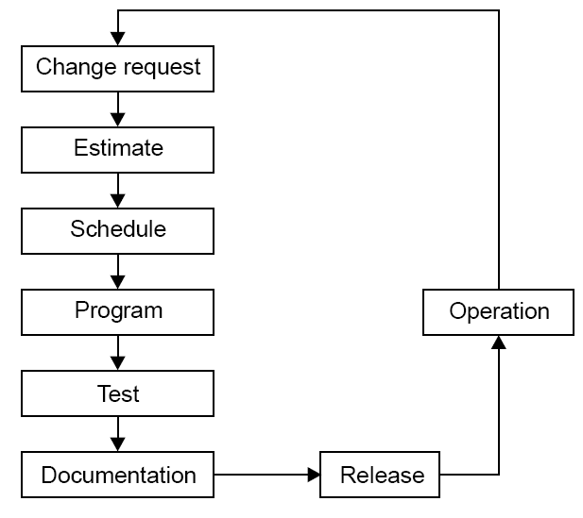
Software Maintenance
•
Taute Maintenance Model
It is a typical maintenance model
and has
eight
phases
in cycle fashion.
The
phases
are shown in Fig.
7
Fig. 7: Taute maintenance model
20

Slide 21
Software
Maintenance
Phases :
1.
Change request phase
2.
Estimate phase
3.
Schedule phase
4.
Programming phase
5.
Test phase
6.
Documentation phase
7.
Release phase
8.
Operation phase
21

Slide 22
Software Maintenance
Estimation
of
maintenance
costs
Phase
Ratio
Analysis
1
Design
10
Implementation
100
Table 3: Defect repair ratio
22

Slide 23
Software Maintenance
•
Belady and Lehman Model
M = P + Ke
(c-d)
where
M : Total effort expended
P : Productive effort that involves analysis, design, coding, testing and evaluation.
K : An empirically determined constant.
c : Complexity measure due to lack of good design and documentation.
d : Degree to which maintenance team is familiar with the software.
23

Slide 24
Software Maintenance
Example – 9.1
The development effort for a software project is 500 person months. The
empirically determined constant (K) is 0.3. The complexity of the code is quite high and is equal to 8. Calculate the total effort expended (M) if
(i) maintenance team has good
level of understanding of the project
(d=0.9)
(ii)
maintenance
team
has
poor
understanding
of
the
project
(d=0.1)
24

Slide 25
Software
Maintenance
Solution
Development effort (P) = 500 PM
K = 0.3
C = 8
(i) maintenance team has good level of understanding of the
project
(d=0.9)
M = P + Ke
(c-d)
= 500 +
_{0.3e}(8-0.9)
= 500 + 363.59 = 863.59 PM
(ii) maintenance team has poor understanding of the project (d=0.1)
M = P + Ke
(c-d)
= 500 +
_{0.3e}(8-0.1)
= 500 + 809.18 = 1309.18 PM
25

Slide 26
Software Maintenance
•
Boehm Model
Boehm used a quantity called Annual Change Traffic (ACT).
“The fraction of a software product’s source instructions which undergo
change during a year either through addition, deletion or modification”.
^{KLOC}added ^{+ KLOC}deleted
ACT =
KLOC_{total}
AME = ACT x SDE
Where, SDE : Software development effort in person
ACT : Annual change Traffic
EAF : Effort Adjustment Factor
months
AME = ACT * SDE * EAF
26

Slide 27
Software Maintenance
Example – 9.2
Annual Change Traffic (ACT) for a software system is 15% per year. The
development effort is 600 PMs. Compute estimate for Annual Maintenance
Effort (AME).
If
life
time
of
the
project
is
10
years,
what
is
the
total
effort
of
the
project
?
27

Slide 28
Software Maintenance
Solution
The development effort = 600 PM
Annual Change Traffic (ACT) = 15%
Total duration for which effort is to be calculated = 10 years
The maintenance effort is a fraction of development effort and be constant.
AME = ACT x SDE
is assumed to
= 0.15 x 600
=
90
PM
Maintenance
effort for 10 years
= 10 x 90 = 90 PM
Total effort
= 600 + 900 = 1500 PM
28

Slide 29
Software Maintenance
Example – 9.3
A software project has development effort of 500 PM. It is assumed that 10%
code
1.
2.
3.
4.
5.
will be modified per year. Some of the cost multipliers
Required software Reliability (RELY) : high
Date base size (DATA) : high Analyst
capability (ACAP) : high Application
experience (AEXP) : Very high
Programming language experience (LEXP) : high
are
given
as:
Other
multipliers
are
nominal.
Calculate
the
Annual
Maintenance
Effort
(AME).
29

Slide 30
Software Maintenance
Solution
Annual change traffic (ACT) = 10%
Software development effort (SDE) = 500 Pm
Using Table 5 of COCOMO
model,
effort
adjustment
factor
can
be
calculated
given below :
RELY = 1.15
ACAP = 0.86
AEXP = 0.82
LEXP = 0.95
DATA = 1.08
30

Slide 31
Software Maintenance
Other
values are nominal values. Hence,
EAF = 1.15
x 0.86 x 0.82 x 0.95 x 1.08
=
0.832
AME = ACT
* SDE * EAF
= 0.1 *
500
*
0.832
=
41.6
PM
AME
=
41.6
PM
31

Slide 32
Software Maintenance
Regression Testing
Regression testing is the process of retesting the
modified parts of the
software
and ensuring
that
no
new
errors have
been
introduced
into
previously test code.
“Regression testing tests both the modified code
and other parts of the
program
that may
be
affected
by
the
program change. It serves
many
purposes :
)
increase confidence in the correctness of the modified program
locate errors in the modified program
preserve the quality and reliability of software
ensure the software’s continued operation
)
)
)
32

Slide 33
Software Maintenance
•
Development
Testing
Versus
Regression
Testing
Sr. No.
Development testing
Regression testing
1.
We create test suites and test plans
We can make use of existing test suite and test plans
2.
We test all software components
We retest affected components that have been modified by modifications.
3.
Budget gives time for testing
Budget often does not give time for regression testing.
4.
We perform testing just once on a software product
We perform regression testing many times over the life of the software product.
5.
Performed under the pressure of release date of the software
Performed in crisis situations, under greater time constraints.
33

Slide 34
Software Maintenance
•
Regression Test Selection
Regression
testing
is very expensive activity and consumes
significant
this effort/
amount of effort / cost. Many techniques are available to reduce
cost.
1.
Reuse the whole test suite
2.
Reuse
the
existing
test
suite,
but
to
apply
a
regression
test
selection technique to select an appropriate subset of the test suite
to be run.
34

Slide 35
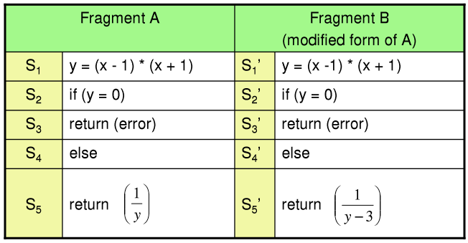
Software
Maintenance
Fragment A
Fragment B
(modified form of A)
S₁
y = (x - 1) * (x + 1)
S₁’
y = (x -1) * (x + 1)
S₂
if (y = 0)
S₂’
if (y = 0)
S₃
return (error)
S₃’
return (error)
S₄
else
S₄’
else
S₅
 ₁ 
return  
S₅’
 1 
 y − 3 
return 

Fig. 8: code fragment A and B
35

Slide 36
Software
Maintenance
Test cases
Test number
Input
Execution History
t₁
x = 1
S₁, S₂, S₃
t₂
x = -1
S₁, S₂, S₃
t₃
x = 2
S₁, S₂, S₅
t₄
x = 0
S₁, S₂, S₅
Fig. 9: Test cases for code fragment A of Fig. 8
36

Slide 37
Software Maintenance
If we execute all test cases, we will detect this divide by zero fault. But we
have to minimize the test suite. From the fig. 9, it is clear that test cases t₃ and t₄ have the same execution history i.e. S₁, S₂, S₅. If few test cases have the same execution history; minimization methods select only one test case. Hence, either t₃ or t₄ will be selected. If we select t₄ then fine otherwise fault not found.
Minimization methods can omit some test cases that might expose fault in
the modified software and so, they are not safe.
A
safe
regression
test
selection
technique
is
one
that, under
certain
assumptions, selects every test case from the original test suite that can
expose faults in the modified program.
37

Slide 38
Software Maintenance
•
Selective
Retest Techniques
techniques may be more economical than the “retest-all”
Selective retest
technique.
Selective retest
techniques are broadly classified in three categories :
techniques : They are based on test coverage criteria.
1.
Coverage
They locate coverable program components that have been modified,
and select test cases that exercise these components.
2.
Minimization
techniques: They work like coverage techniques,
except that they select minimal sets of test cases.
3.
Safe techniques: They do not focus on coverage criteria; instead they
select every test case that cause a modified program to produce different output than its original version.
38

Slide 39
Software Maintenance
Rothermal identified
categories
in
which
regression
test
selection
techniques can be compared and evaluated. These categories are:
Inclusiveness measures the extent to which a technique chooses test
cases that will cause the modified program to produce different output than the original program, and thereby expose faults caused by modifications.
Precision measures the ability of a technique to avoid choosing test cases that will not cause the modified program to produce different output than the original program.
Efficiency measures the computational cost, and thus, practically, of a technique.
Generality measures the ability of a technique to handle realistic and
diverse language constructs, arbitrarily complex modifications, and realistic testing applications.
39

Slide 40
Software Maintenance
Reverse Engineering
Reverse
unknown
engineering
is the process followed in order
to
find
difficult,
and
hidden
information
about
a
software
system.
40

Slide 41
Software Maintenance
•
Scope and Tasks
The areas there reverse engineering is applicable include
(but
not limited
to):
1.
2.
3.
Program comprehension
Redocumentation and/ or document generation
Recovery of design approach and design details abstraction
Identifying reusable components
Identifying components that need restructuring
Recovering business rules, and
Understanding high level system description
at
any
level
of
4.
5.
6.
7.
41

Slide 42
Software Maintenance
Reverse Engineering encompasses a wide array of tasks related to understanding
and modifying software system. This array of tasks can be broken into
classes.
a
number
of
)
Mapping
between application and program
domains
Problem/
application domain
Mapping
Programming/
implement domain
Fig.
10: Mapping between application and domains program
42

Slide 43
Software Maintenance
)
Mapping between concrete and abstract levels
)
Rediscovering high level structures
)
Finding
missing
links
between
program
syntax
and
semantics
)
To
extract
reusable
component
43

Slide 44
Software Maintenance
•
Levels of Reverse Engineering
Reverse Engineers detect low level implementation constructs
them with their high level counterparts.
and replace
The process eventually results
in
an
incremental
formation
of
an
overall
architecture
of
the
program.
44

Slide 45
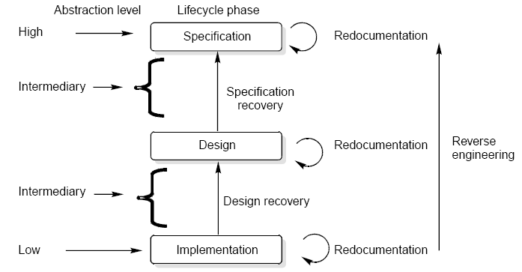
Software
Maintenance
Fig. 11: Levels of abstraction
45

Slide 46
Software Maintenance
Redocumentation
Redocumentation
is
the
recreation
of
a
semantically
equivalent
representation within the same relative abstraction level.
Design recovery
Design recovery entails identifying and extracting meaningful
higher level
abstractions beyond those obtained directly from examination of the source
code. This may be achieved from a combination of code, existing design documentation, personal experience, and knowledge of the problem and application domains.
46

Slide 47
Software Maintenance
Software Re-Engineering
Software re-engineering
is concerned with taking existing legacy systems
and re-implementing them to make them more maintainable.
The
critical
distinction
between
re-engineering
and
new
software
Fig.12.
development
is
the
starting
point
for
the
development
as
shown
in
47

Slide 48
Software
Maintenance
System
specification
Existing
software system
Design and
implementation
Understanding
and transformation
New system
Re-engineered
system
Fig. 12: Comparison of new software development with re-engineering
48

Slide 49
Software Maintenance
The following suggestions may be useful for the modification
code:
of
the
legacy
Study code well before attempting changes
Concentrate on overall control flow and not coding
Heavily comment internal code
Create Cross References
Build Symbol tables
Use own variables, constants and declarations to localize
Keep detailed maintenance document
Use modern design techniques
the effect
49

Slide 50
Software Maintenance
•
Source Code Translation
1.
Hardware platform
update: The organization may wish to
change its standard hardware platform. Compilers for the original
language may not be available on the new platform.
2.
Staff
Skill Shortages: There may be lack of trained
maintenance staff for the original language. This is a particular
problem where programs were written in some non standard language that has now gone out of general use.
3.
Organizational policy changes: An organization may decide to
standardize on a particular language to minimize its support software costs. Maintaining many versions of old compilers can be very expensive.
50

Slide 51
Software Maintenance
•
Program Restructuring
1.
Control flow driven restructuring: This involves the imposition
of a clear control structure within the source code and can be
either inter
modular or intra modular in nature.
2.
Efficiency
function or
driven restructuring: This involves restructuring a
algorithm to make it more efficient. A simple example
is the replacement of an IF-THEN-ELSE-IF-ELSE
a CASE construct.
construct
with
51

Slide 52
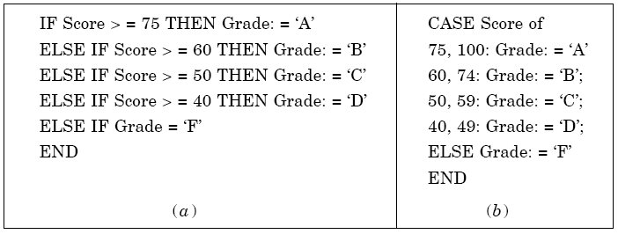
Software
Maintenance
Fig. 13: Restructuring a program
52

Slide 53
Software Maintenance
3.
Adaption
driven
restructuring: This involves changing the
coding style in order to adapt the program to a new programming
language or new operating environment, for instance changing
an imperative
LISP.
program
in
PASCAL
into
a
functional
program
in
53

Slide 54
Software Maintenance
Configuration Management
The process of software development and maintenance is controlled
is
is to
called
configuration
management.
The
configuration
management
different in
development and
maintenance
phases
of
life
cycle
due
different environments.
•
Configuration Management Activities
The
1.
2.
3.
4.
activities are divided into four broad categories.
The identification of the components and changes
The control of the way by which the changes are made
Auditing the changes
Status accounting recording and documenting all the activities that have take place
54

Slide 55
Software Maintenance
The
following documents are required for these activities
Project plan
Software requirements specification document
Software design description document
Source code listing
Test plans I procedures
User manuals
I test cases
55

Slide 56
Software Maintenance
•
Software Versions
Two types of versions namely revisions (replace) and variations
(variety).
Version Control :
A version control tool is the first stage towards being able
to manage
multiple versions. Once it is in place, a detailed record of every version of
the software must be kept. This comprises the
Name of each source code component, including the variations and
revisions
The
The
The
versions of the various compilers and linkers used
name of the software staff who constructed the component date and the time at which it was constructed
56

Slide 57
Software Maintenance
•
Change Control Process
Change
control
process
comes
into
effect
when
the software
and
associated
documentation
are
delivered
to
configuration
management
change
request
form
(as
shown
in
fig.
14),
which
should
record
the
recommendations
regarding
the
change.
57

Slide 58
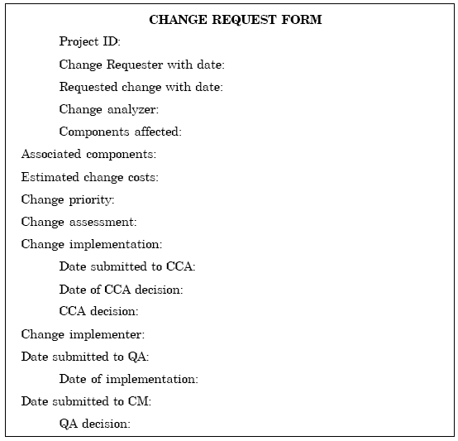
Software
Maintenance
Fig. 14: Change request form
58

Slide 59
Software Maintenance
Documentation
Software documentation is the written record of the facts about a
software system
recorded
with
the
intent
to
convey
purpose,
content
and
clarity.
59

Slide 60
Software
Maintenance
•
User
Documentation
S.No.
Document
Function
1.
System Overview
Provides general description of system’s functions.
2.
Installation Guide
Describes how to set up the system, customize it to local hardware needs and configure it to particular hardware and other software systems.
3.
Beginner’s Guide
Provides simple explanations of how to start using
the system.
4.
Reference Guide
Provides in depth description of each system facility
and how it can be used.
5.
Enhancement
Booklet Contains a summary of new features.
6.
Quick reference card
Serves as a factual lookup.
7.
System administration
Provides information on services such as net-
working, security and upgrading.
Table 5: User Documentation
60

Slide 61
Software Maintenance
•
System Documentation
It refers to those documentation
containing all facets of system, including
analysis,
diagnosis
specification,
design,
implementation,
testing,
security,
error
and
recovery.
61

Slide 62
Software
Maintenance
•
System
Documentation
S.No.
Document
Function
1.
System Rationale
Describes the objectives of the entire system.
2.
SRS
Provides information on exact requirements of system as agreed between user and developers.
3.
SpecificationI Design
Provides description of:
(i) How system requirements are implemented.
(ii) How the system is decomposed into a set of interacting program units.
(iii) The function of each program unit.
4.
Implementation
Provides description of:
(i) How the detailed system design is expressed in some formal programming language.
(ii) Program actions in the form of intra program comments.
62

Slide 63
Software
Maintenance
S.No.
Document
Function
5.
System Test Plan
Provides description of how program units are tested individually and how the whole system is tested after integration.
6.
Acceptance Test Plan
Describes the tests that the system must pass before users accept it.
7.
Data Dictionaries
Contains description of all terms that relate to the software system in question.
Table 6: System Documentation
63

Slide 64
Reference
Software Engineering -KK Aggarwal and Yogesh Singh.
Software Engineering: A Practitioner's Approach- Roger S. Pressman

